Slide 1
Mesh Analysis

Slide 2
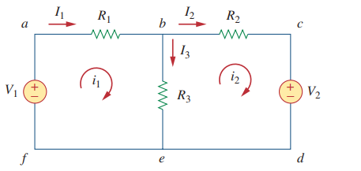
Loop and Mesh
Loop: Any closed path
Mesh : A mesh is a loop which does not contain any other loops within it
In this figure, paths abefa and bcdeb are meshes, but path abcdefa is not a mash

Slide 3
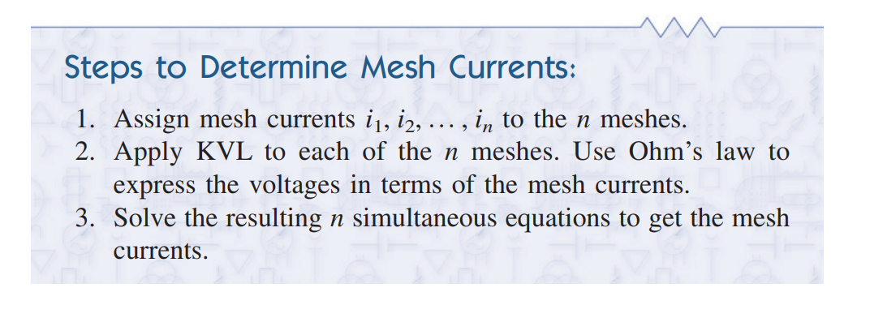
Mesh Analysis
Goal : Finding the mesh Currents.

Slide 4
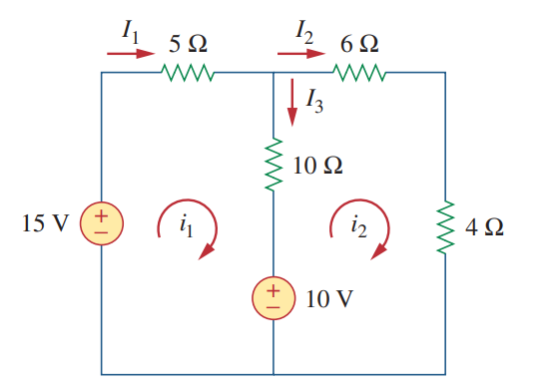
Math Problem Practice:
For the circuit in Fig , find the branch currents I₁, I₂, I₃ and using mesh analysis.
Reference: Sadiku_Example_3.5

Slide 5
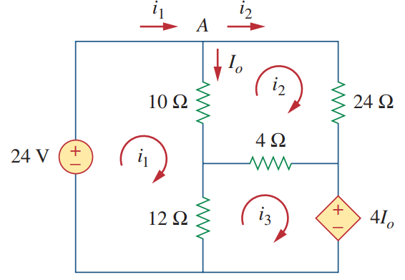
Math Problem Practice:
Use mesh analysis to find the current I_{o} in the circuit of Fig. below
Reference: Sadiku_Example_3.6

Slide 6
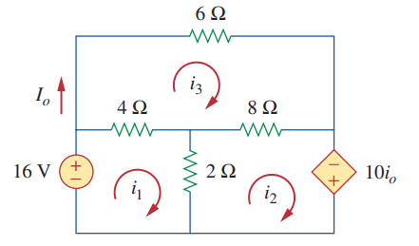
Math Problem Practice:
Use mesh analysis to find the current I_{o} in the circuit of Fig. below
Reference: Sadiku_Practice_Problem_3.6

Slide 7
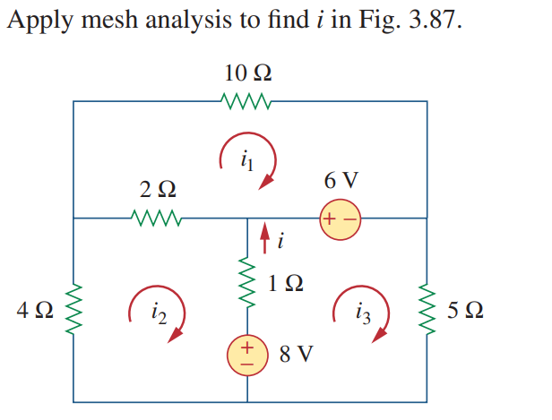
Math Problem Practice:
Reference: Sadiku_Exercise_Problem_3.41

Slide 8
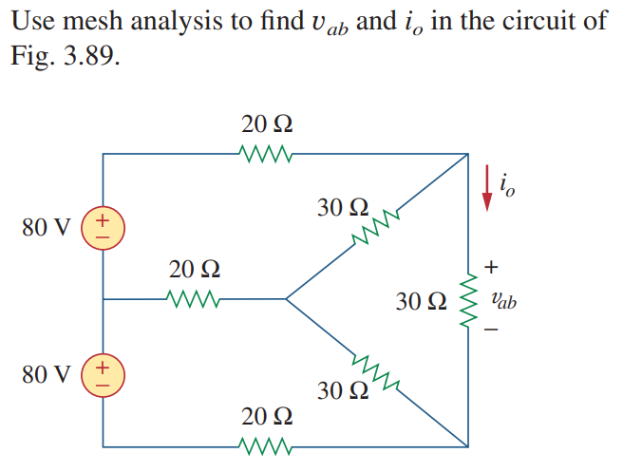
Math Problem Practice:
Reference: Sadiku_Exercise_Problem_3.43

Slide 9
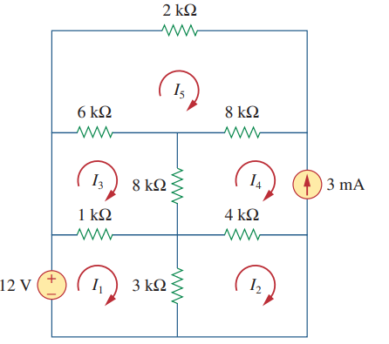
Mash Analysis with Current Sources
Find the mesh currents.
Reference: Sadiku_Exercise_Problem_3.53

Slide 10
Math Problem Practice:
Find the mesh currents.
Reference: Sadiku_Exercise_Problem_3.53

Slide 11
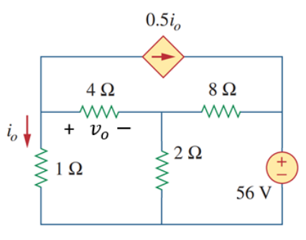
Math Problem Practice:
Summer 2022
Calculate the currents through all the resistors using mesh analysis method and find vo.

Slide 12
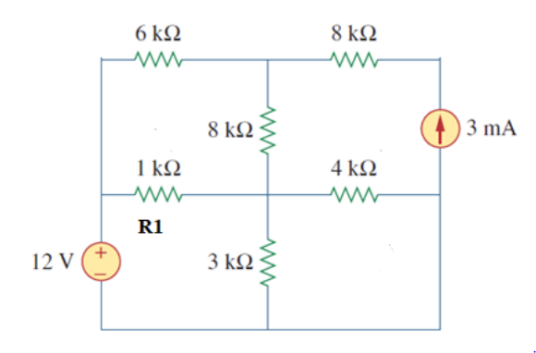
Math Problem Practice:
Fall 2022
(a) Determine the currents in all resistors using Mesh Analysis.
(b) Determine the power absorbed the in R1 resistor.

Slide 13
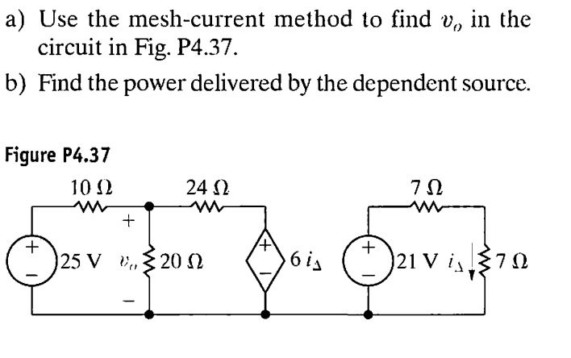
Math Problem Practice:
Reference: Nilsson_Exercise_Problem_4.37

Slide 14
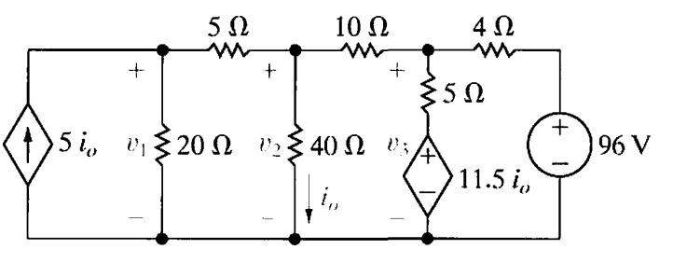
Math Problem Practice:
Find the mesh currents.

